Slide 1

107
Financial Management I
Stacey Church
Venue Management School – Year 1
June 2026

Slide 2
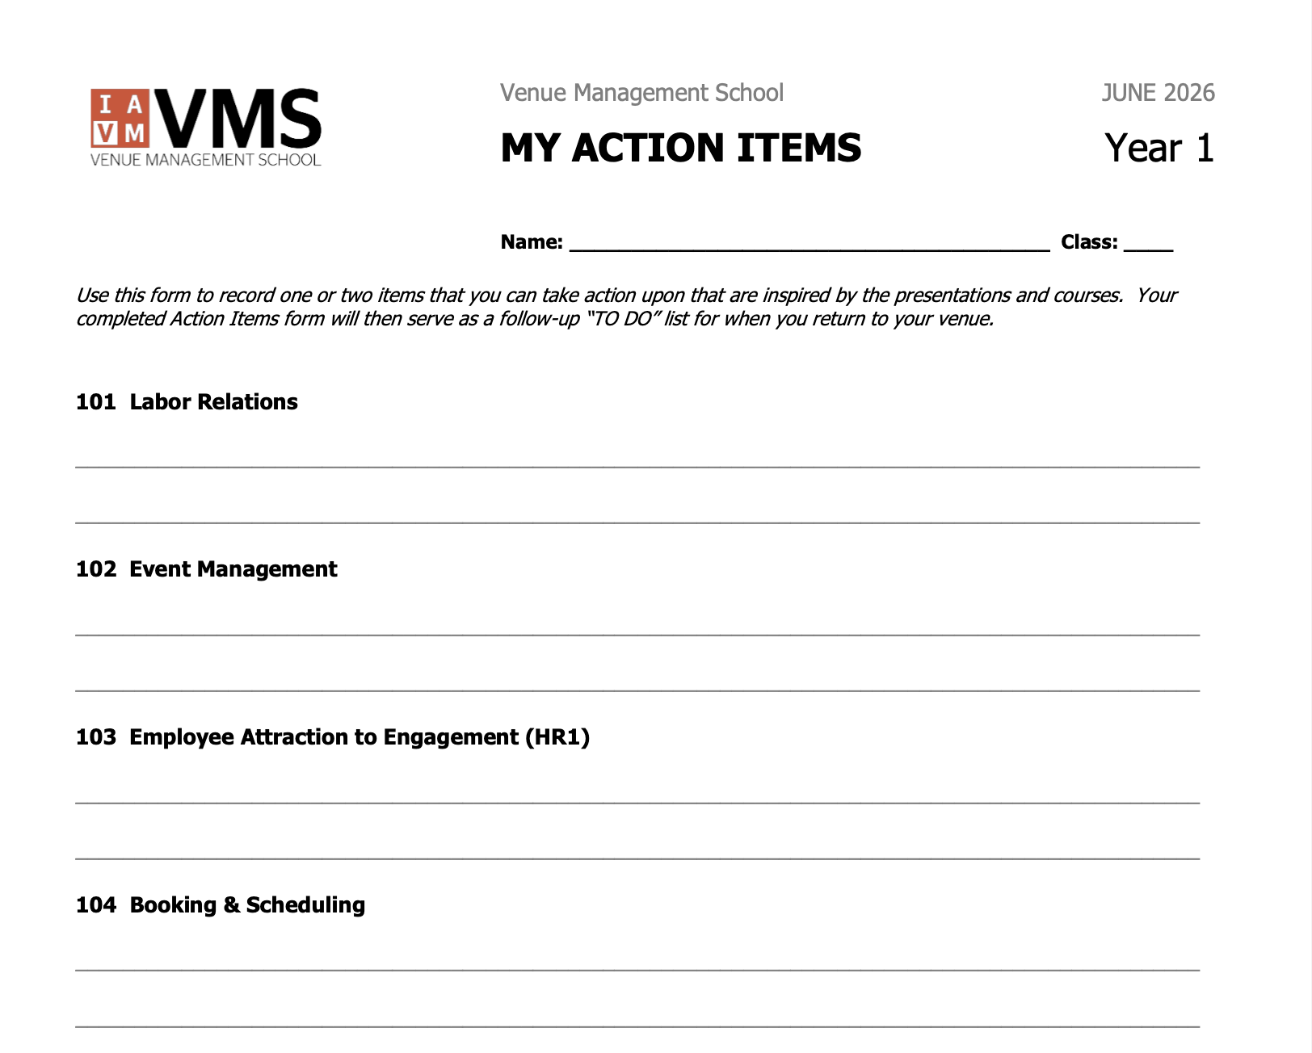
Action Item Form
Don’t forget to make notes on your Action Item form.

Slide 3
LEARNING OBJECTIVES
Understand the role of accounting in venue operations
Explain accounts payable and accounts receivable
Identify how operational activity creates financial transactions
Connect financial information to venue decision making
Notes:
TEST INFO – HALF and HALF
Learning Objectives – WHAT WE’LL GO OVER AND WHAT YOU SHOULD KNOW BY THE END
WHAT I HOPE FOR IN THE CLASS – ENGAGEMENET
WHAT I HOPE FOR YOU AT THE END OF CLASS –
COMFORTABLE DISCUSSING FINANCIAL INFORMATION
READING BASIC FINANCIAL STATEMENTS
IDENTIFY INTERNAL CONTROLS IN YOUR VENUE

Slide 4
Which Financial Question Is Most Important?
A. Where does the money come from?
B. Where does the money go?
C. Who owes the money?
D. Who do we owe?
Raise your hand for the one you think matters most.

Slide 5
What is Accounting?
A way to communicate the financial
health of an organization to stakeholders.
Track Activity
Revenue and expenses
Measure Results
Financial performance
Support Decisions
Information leaders use
Accounting helps turn operations into information.

Slide 6
Why Venue Leaders Need Financial Information
Protect Resources
Know where the money is going
Support Operations
Fund events and services
Make Decisions
Plan for the future
Every operational decision has a financial impact.

Slide 7
CASH vs. ACCRUAL
When is activity recorded?
Cash Accounting
Record activity when money is received or paid.
Why Venue Leaders Care
Accrual accounting provides better operational oversight.
Accrual Accounting
Record activity when it occurs, even if cash hasn't moved.
Example
Receive an invoice today, pay it next month.
Notes:
ABSTRACT ART FOR THE CREATIVES (lol)
EXAMPLES OF EACH FACT (GIVE SCENARIO ASK CLASS)
#1 – EVENT HAPPENS IN JUNE, PAYMENT IN JULY, REVENUE RECORDED IN JULY
#2 – SEPARATE PLUMBING REPAIRS IN OCTOBER AND NOVEMBER, VENDOR PAID IN DECEMBER, EXPENSE RECORDED IN DECEMBER
VS.
#3 - EVENT HAPPENS IN JUNE, PAYMENT IN JULY, REVENUE RECORDED IN JUNE
#4 - SEPARATE PLUMBING REPAIRS IN OCTOBER AND NOVEMBER, VENDOR PAID IN DECEMBER, SEPARATE EXPENSES RECORDED IN OCTOBER AND NOVEMBER

Slide 8
Accounts Payable
Money the venue owes.
Receive Goods or Services
Finance Fact:
Accounts Payable is typically a credit balance because it represents money the venue owes.
Receive Invoice
Pay Vendor
Accounts payable begins when goods or services are received.

Slide 9
Accounts Payable: Why It Matters
QUESTION | WHY IT MATTERS
What do we owe? | Manage obligations
When is payment due? | Avoid late fees
Was the purchase approved? | Maintain controls
Has the invoice been received? | Ensure accurate payment
Effective accounts payable supports cash management and vendor relationships.

Slide 10
Accounts Receivable
Money owed to the venue.
Provide Service
Finance Fact:
Accounts Receivable typically carries a debit balance because it represents money owed to the venue.
Invoice Customer
Collect Payment
Accounts receivable begins when services are provided before payment is received.

Slide 11
Accounts Receivable: Why It Matters
QUESTION | WHY IT MATTERS
Who owes us money? | Track outstanding balances
How old is the receivable? | Older receivables are less likely to be collected
Has an invoice been sent? | Support timely payment
When should we follow up? | Improve cash flow
Aging matters: the longer an invoice remains unpaid, the lower the likelihood of full collection.

Slide 12
Financial Information Starts With Operations
OPERATE
Events occur
RECORD
Financial activity captured
REPORT
Information summarized
DECIDE
Leaders take action
Operations create the financial story.

Slide 13
PUTTING IT ALL TOGETHER
How does financial information support venue operations?
Accounts Payable tracks money owed by the venue.
Accounts Receivable tracks money owed to the venue.
Financial information helps leaders make better decisions.
Let’s apply these concepts to a real venue scenario.

Slide 14
Where Does The Money Go?
Think like a venue leader, not an accountant.
1. Review your scenario
2. Identify
• Financial processes
• Impacted departments
3. Discuss
• Why the activity matters financially
• How it affects venue operations
4. Determine
• Potential financial or operational risks
5. Present
• One financial concern
• One operational concern
• One recommended action
Focus on how operations create financial consequences.

Slide 15
Discussion: What Did We Find?
QUESTION | PURPOSE
What happened? | Identify activity
Who was impacted? | Connect operations
What was the risk? | Understand consequences
What should leadership do? | Support decisions
Good venue leaders connect operations to financial outcomes.

Slide 16
Learning Objectives – Review
What accounting is
Accounts payable
Accounts receivable
Financial impact of operations
Financial statements tell us what happened. Budgeting helps us decide what happens next.
Financial information helps venue leaders understand what happened and decide what to do next.

Slide 17
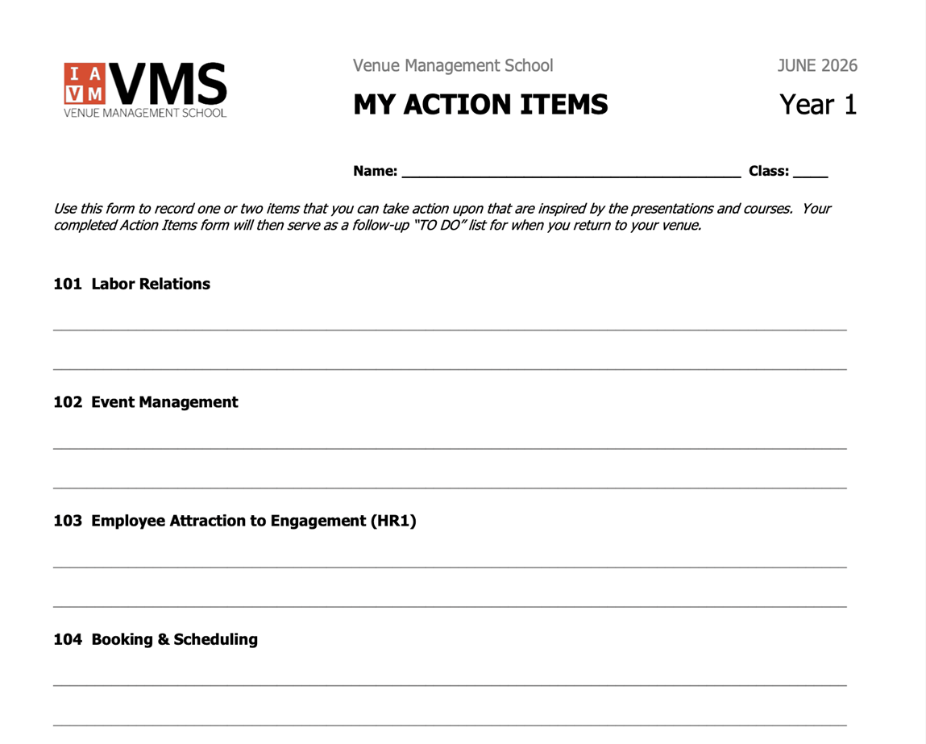
Action Item Form
Reminder…
Don’t forget to make notes on your Action Item form.

Slide 18
Thank you!
107
Financial Management I
Stacey Church
Please complete the course evaluation now.
Venue Management School – Year 1
June 2026

